Slide 1
Confidentiality Management in Aggregate Data Tables
τ-Argus

Slide 2
Outline
Creating Input Data
  Microdata
  Metadata
From primary to secondary suppression
  Specifying tables
  Avoiding Primary suppression
  Computing secondary suppression
  Audit
Outputs
  Format SBS
  Excel Formatting
Three special cases
Linked tables management
Controlled rounding
Tabulated data

Slide 3
Outline
Creating Input Data
  Microdata
  Metadata
From primary to secondary suppression
  Specifying tables
  Avoiding Primary suppression
  Computing secondary suppression
  Audit
Outputs
  Format SBS
  Excel Formatting
Three special cases
Linked tables management
Controlled rounding
Tabulated data

Slide 4
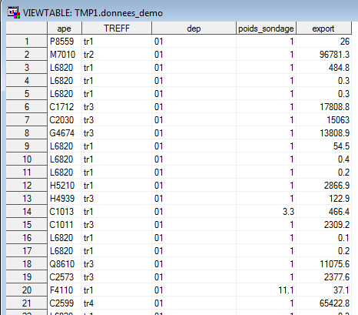
Microdata – from a SAS table
Input variable types :
ventilation variables
weigh
response variables
holding variable (not shown here)
Notes:
Eventuellement dire qu’il existe d’autres types de variables (var request notamment, var de coût …)

Slide 5
Microdata – converting a SAS table to ascii file (.asc)
/** Étape 1 : conversion en caractère **/
data microDonnees;
set demo.Donnees_demo;
/* 2 variables numériques avec un chiffre après la virgule que l'on convertit en variable caractère */
poids = put(poids_Sondage, 6.1);
exportt = put(export, 10.1);
run;
/** Étape 2 : création du fichier plat **/
filename asc "D:\dossier de travail\Donnees_demo.asc";
data _NULL_;
set microdonnees;
file asc;
put
treff 1-4
APE 6-11
dep 13-14
poids 16-21
exportt 23-32 ;
run;
Notes:
Justifier le passage en caractère : pour que les var soient alignées à droite, TA s’attend(ait?) à ce que les points des var num soient alignés.

Slide 6
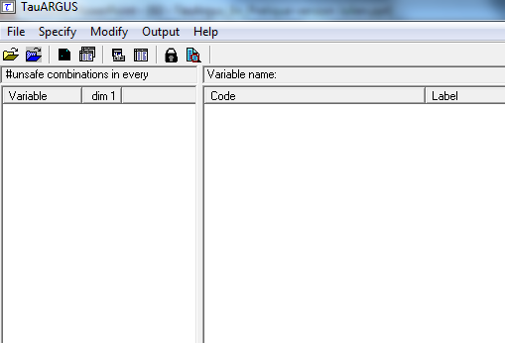
Tau-Argus: Exploring the menu
1 - Opening of microdata (.asc) and possibly associated metadata (.rda)
2 - Modification of the metadata
4 - Selection of the table on which you want to work
3 - Specifying tables
5 - Display of the tables and access to the console allowing the management of the secondary secret, the management of the broadcast structure, the recording of an output
1 - Opening tabulated data (.tab)
And its metadata (.rda)
6 - Export of the secret mask
7 - Display of the report

Slide 7
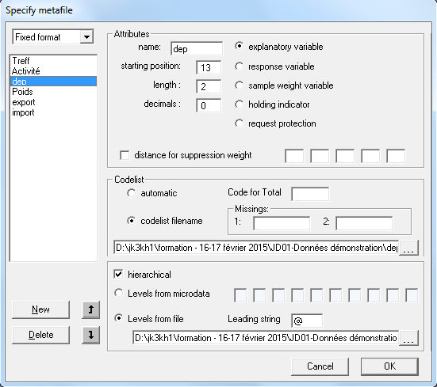
Metadata - variables specification
1 - We prefer the fixed format
3 - Description of the variable:
Name
Position and length in the file (see sas export)
Number of decimals for numeric variables
Type
4 – Codelist
- management of labels ... little interest
codes used for missing values
5 – Specifying information about hierarchical variables:
manually : A88/A272/APE will give for example :
or via a flat file (.hrc).
2 - We add the right number of variables
Notes:
Faire un petit top sur les fichiers plats :
Préférer les variables dont les modalités font la même longueur …
Ou bien les caller à droite dans le .ASC et ajouter les espaces dans le fichier hrc.

Slide 8
Outline
Creating Input Data
  Microdata
  Metadata
From primary to secondary suppression
  Specifying tables
  Avoiding Primary suppression
  Computing secondary suppression
  Audit
Outputs
  Format SBS
  Excel Formatting
Three special cases
Linked tables management
Controlled rounding
Tabulated data

Slide 9
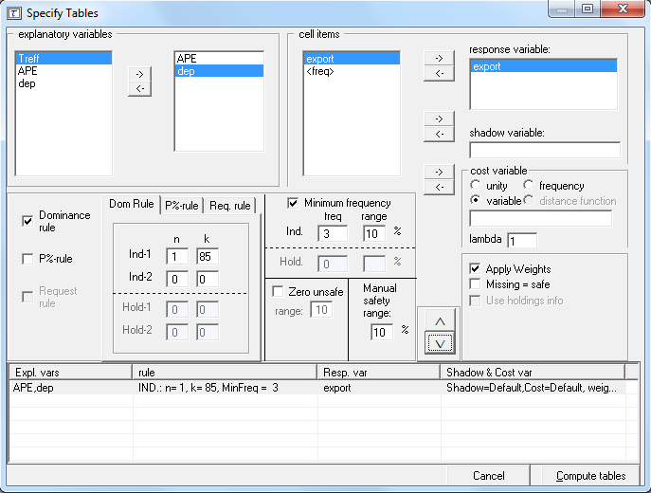
Specifying tables - selecting variables
Selection of ventilation variables for a given table
Variable on which the primary secret will be calculated
Selecting the Response Variable

Slide 10

Specifying tables - choosing the cost variable
Unity
Minimize the number of hidden boxes in the secondary secret.
Frequency
Minimization of the number of records concerned by the boxes in secondary secret (number of companies for example).
Variable
Minimization of the sum of the variable broken down in the tables (lost information).
Another variable can be chosen to calculate the cost of the loss.
Lambda
Allows to consider the variable x^{λ} , or ln(x) when λ=0.

Slide 11
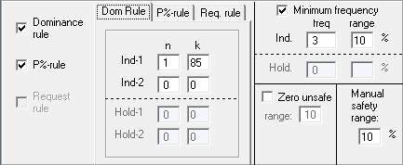
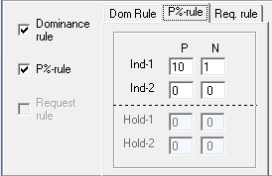
Avoiding primary secrecy - dominance, frequency and P%
Frequency rule or manually secured box:
- the width of the interval must be defined
- relative to the total of the box
- symmetrical protection interval
- can be defined more precisely by using an a priori file
Rule of dominance or P%
Interval calculated automatically
So as not to be able to retrieve the sensitive individual data (first contributors to the total of the box)
Possibility to hide the boxes equal to 0
Definition of a minimum protection interval
Defined absolutely

Slide 12
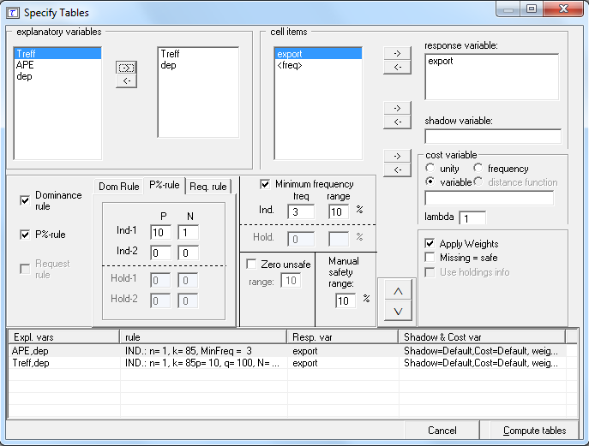
Avoiding Primary Secrets - Weight and Holding
Taking weights into account
Missing values considered secure
Taking holding into account
Tables are dragged
Once all tables are defined, they are generated.
List of tables (maximum 10 at a time)
Notes:
Revenir à l’oral sur les histoire de valeurs manquantes (qui ne sont pas des valeurs manquantes).

Slide 13
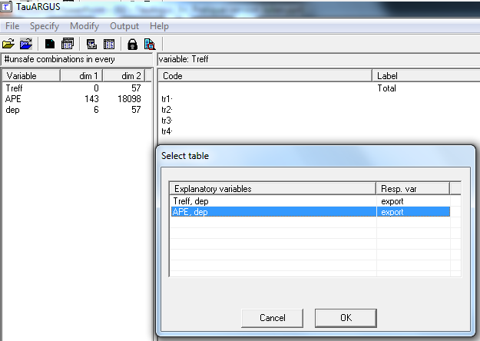
Calculate the secondary secret - selection of the work table
Selection of the table on which you want to work

Slide 14
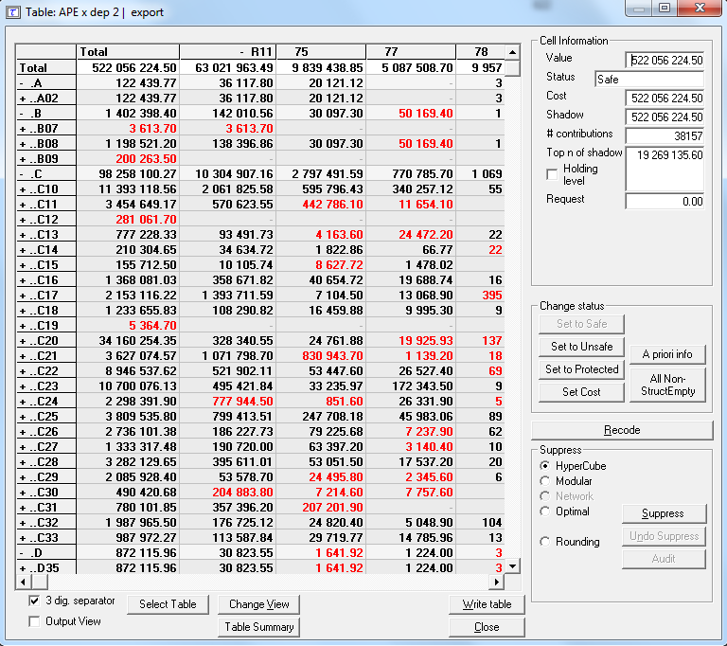
Calculate the secondary secret - view the table: cell information
Information on a given box:
- status : safe/unsafe (box in black/red)
contributions : number of contributors
top n of shadow : value of the first contributor of the box, to be compared with the value of the box
protection interval : limits of the protection interval defined for the primary secret boxes

Slide 15
Calculate the secondary secret - view the table: change status
Changing the status of a box manually:
set to safe/unsafe : Force the broadcast / non-broadcast of a box
- set to protected : The box can not be chosen for secondary secrecy (infinite cost)
set cost : Change in cost for secondary secrecy
a priori info : from a flat file (.hst), you change the status of a list of boxes

Slide 16
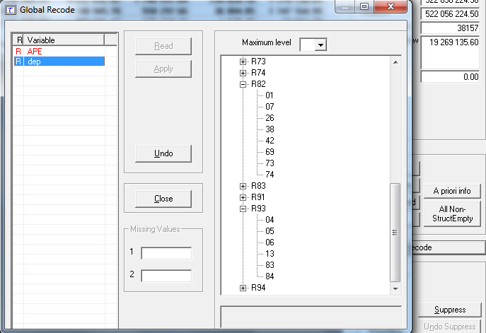
Calculate the secondary secret - view the table: recode
The maximum level allows to recode all the modalities at once, making them rise of x notches.
Here we go from department to region ...
... But if we wish, for example, to keep the departments of regions 11, 82 and 93, we can modify the structure manually.
First the variable is selected, then recode, then apply and then close.
Notes:
Pour les données demo, on recope l’APE en A21 (une lettre)

Slide 17
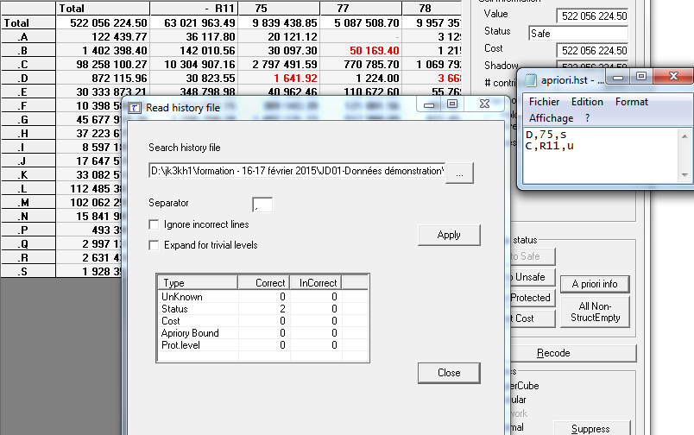
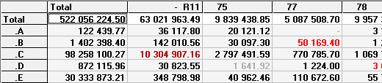
Calculate the secondary secret - view the table: a priori
Applying an a priori secret structure.
It is not necessary to specify all the boxes in the table.
Be careful not to specify empty boxes.
Notes:
Ignore… => ignore les erreurs de codification
Expand …=> répercute en cascade l’apriori sur les niveaux hiérarchiques inférieurs, sous réserves qu’ils soient égaux. (H53=H531=H5310=H5310Z)

Slide 18
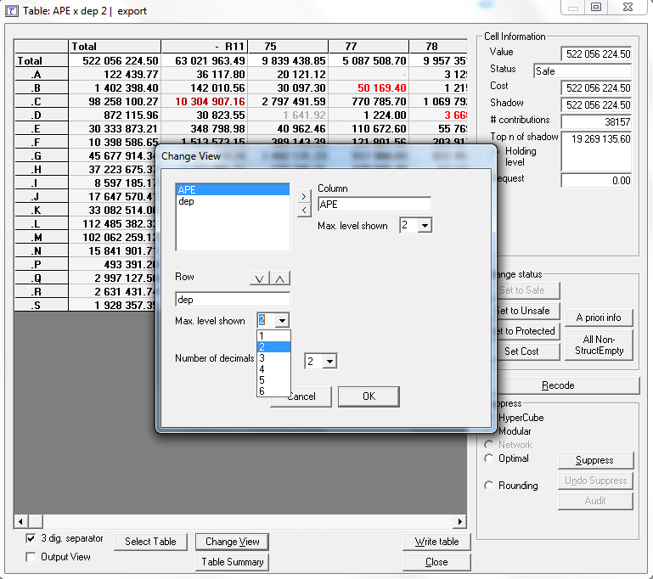
Calculate secondary secret - view table: change view
Changing the display of the table on the screen (this does not modify the actual structure of the table).

Slide 19
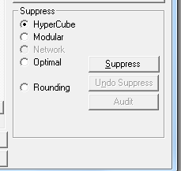
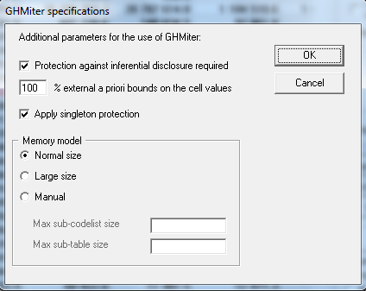
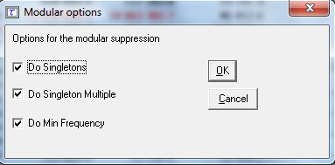
Calculate Secondary Secret - What Secondary Secret Method?
Hypercube
Sequential treatment of cells under primary secret (search for the least expensive suppression scheme).
Free and fast method.
Optimal
Overall minimization of the cost of hiding boxes
Under the constraint of respecting the protection intervals.
Method sometimes very slow.
Modular
For hierarchical tables, the problem is split: the optimal method is applied on the different sub-tables.
Faster to process than the optimal method.

Slide 20
Calculating the secondary secret – managing singletons problems in Tau-Argus
Singleton
➔ Cell with one contributor, he can know that is the only contributor to the box.
➔ Complementary secondary suppression if :
- two singletons in the same row or column
- un singleton et une cellule cachée en secret primaire
- two cells hidden due to a frequency problem whose sum of the number of contributors is still insufficient (this problem does not arise with the rule of three units)
Method | Singleton management
Hypercube | Yes (automatically)
Modular | Yes (optional)
Network | Not offered
Optimal | Yes (optional)

Slide 21
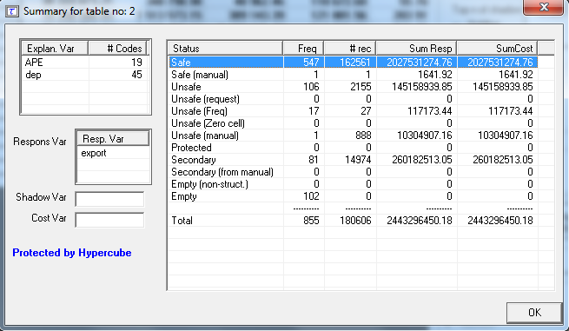
Calculate the secondary secret - view the table: summary
The most interesting information :
the primary secret of frequency : Unsafe(freq)
the primary secret of dominance /P% : Unsafe
manually protected boxes : Safe(manual)
Secondary secrecy : Secondary
The costs of these different categories of secrecy.
Notes:
Rajouter à l’oral la description des colonnes

Slide 22
Calculate Secondary Secrecy - Different Methods for Different Results
Method | Number of boxes deleted in secondary secret | Cost of boxes deleted | Required calculation time
Hypercube (free method) | 81 (9.47%) | 260 182 513 (10.64%) | 1 second
Modular (paying method) | 64 (7.48%) | 26 017 917 (1.06%) | 1 minute and 4 seconds
Optimal (paying method) | 140 (16.37%) | 25 461 484 (1.04%) | 10 minutes (not "optimal" solution)

Slide 23
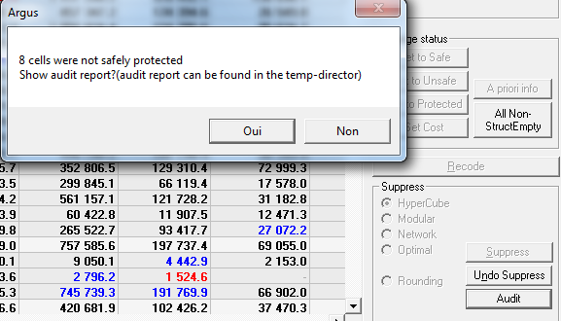
Audit

Slide 24
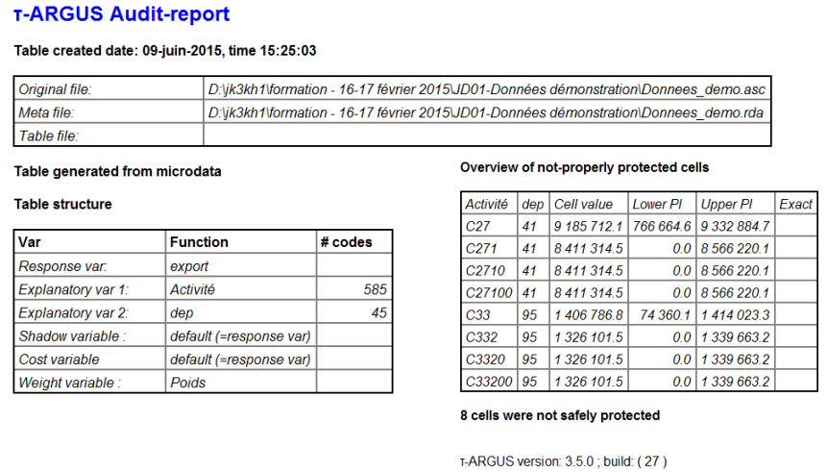
Audit - Protection Intervals and Audit Intervals
Notes:
Liste des cases dont les intervalles des protections ne sont pas inclus dans les intervalles des possibles.

Slide 25
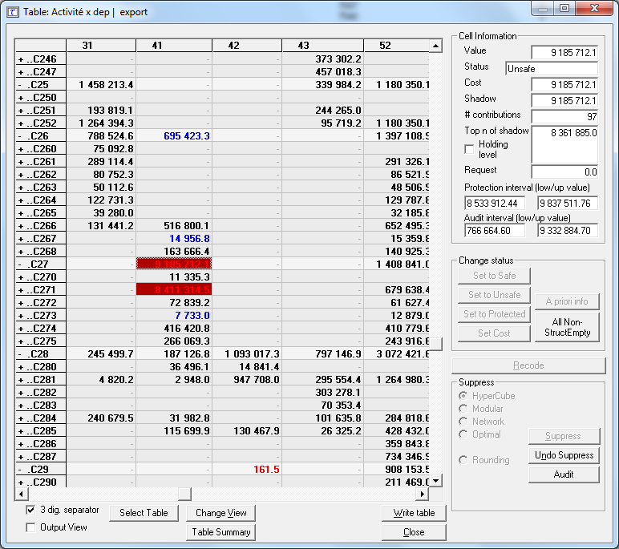
Audit - Protection Intervals and Audit Intervals
Protection interval
Limits of the protection interval defined for the primary secret boxes
Audit interval
Interval of the possibilities that a user is likely to find thanks to the additivity and positivity relationships of the cells.
Notes:
Précisez que ce ne sont pas les mêmes données

Slide 26
Outline
Creating Input Data
  Microdata
  Metadata
From primary to secondary suppression
  Specifying tables
  Avoiding Primary suppression
  Computing secondary suppression
  Audit
Outputs
  Format SBS
  Excel Formatting
Three special cases
Linked tables management
Controlled rounding
Tabulated data

Slide 27
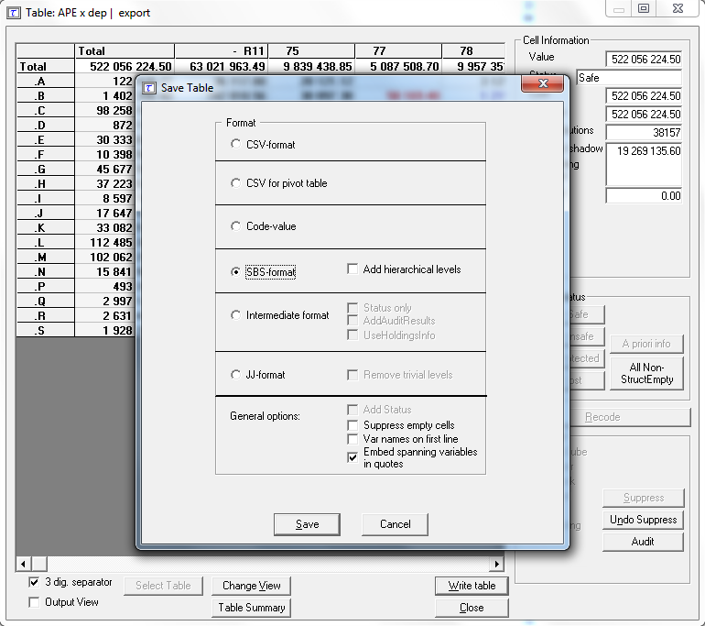
Exporting your data: different options
Format requested by Eurostat, which is systematically used in methodology department
Notes:
Occasion de rappeler qu’on propose nos services pour faire les masques

Slide 28
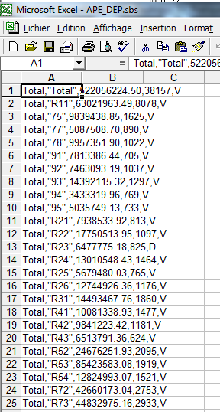
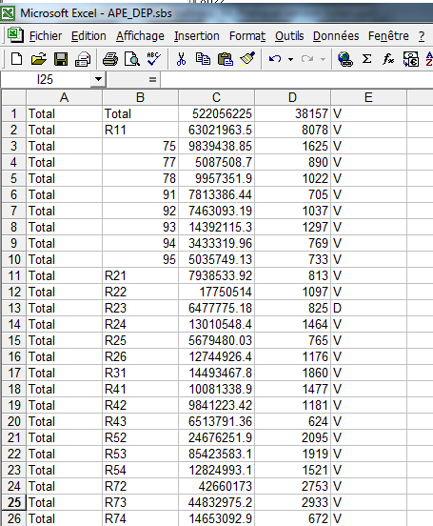
Export to the format requested by Eurostat (.sbs): Formatting
➔ selection of column A
menu
data
➔ convert
➔ next
➔ tick « , »
➔ complete
Meaning of the flags (column E):
V : can be shown
A : primary frequency secret
B : primary secret of dominance
F : primary secret linked to P%
D : secondary secret
Notes:
« , » c’est le séparateur

Slide 29
Outline
Creating Input Data
  Microdata
  Metadata
From primary to secondary suppression
  Specifying tables
  Avoiding Primary suppression
  Computing secondary suppression
  Audit
Outputs
  Format SBS
  Excel Formatting
Three special cases
Linked tables management
Controlled rounding
Tabulated data

Slide 30
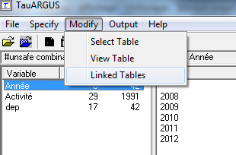
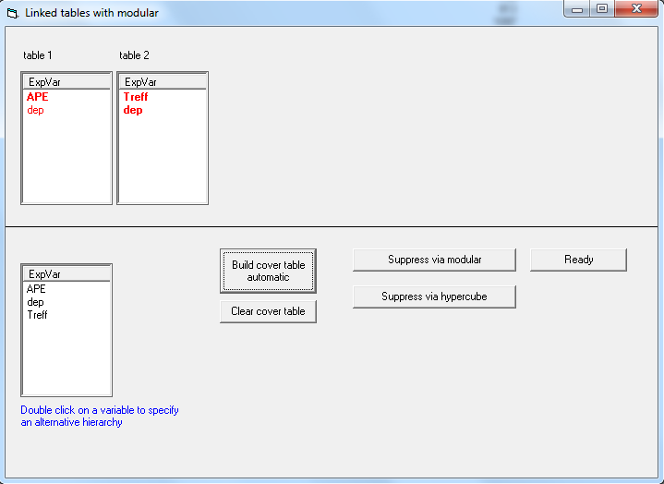
Managing linked tables
1 – We define the global table to be protected
2 – The method is chosen

Slide 31
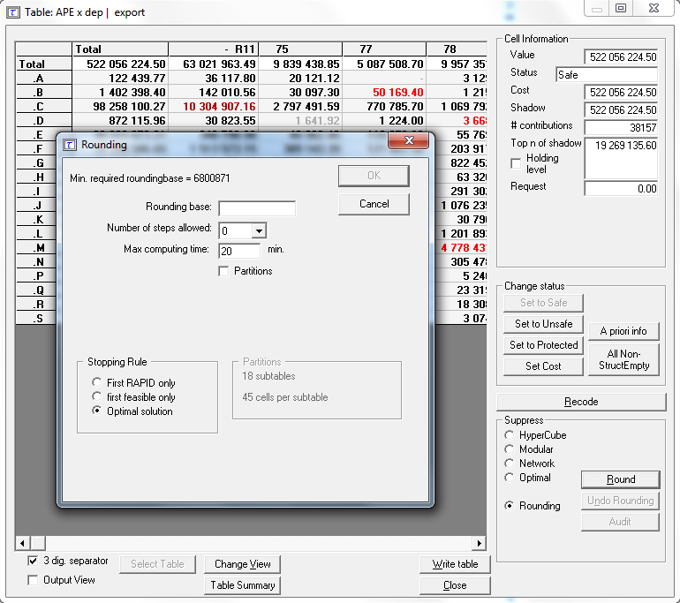
Controlled rounding - another way to manage secrecy
Minimum required as rounding base
Notes:
Bien préciser qu’ici, ça donne n’importe quoi …

Slide 32
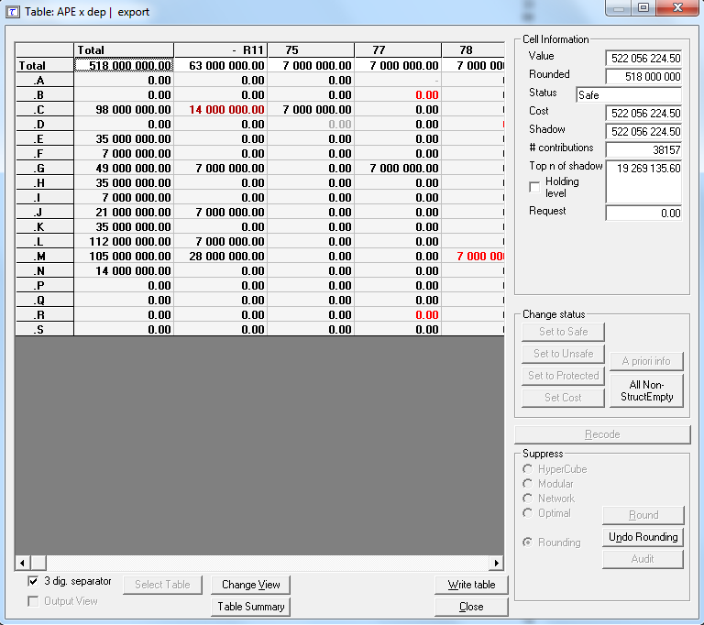
Controlled rounding - another way to manage secrecy
A method sometimes brutal ...

Slide 33
Tabulated data - construction of a flat file of tabulated data (.tab)
/* Étape 1 : création de la tabulation */
/* Au préalable, on crée un variable de comptage "un" pour que la fréquence sous Tau-Argus prenne en compte le poids */
proc means data = demo.Donnees_demo n sum max noprint ;
var export ;
class APE dep ;
output out= ape_dep n=un sum = export max = max_export ;
run;
data ape_dep ;
set ape_dep ;
if ape="" then ape = "Total";
if dep="" then dep = "Total";
run;
/* Étape 2 : création du fichier plat */
data _null_;
File "Z:\19-20 mai 2016\02-TauArgus_En_Pratique-mai 2016\Données démonstration\donnees_demo_tabulees.tab" dsd dlm=';' ;
Set ape_dep (keep=ape dep un export max_export);
Put ( _all_)(+0);
run;

Slide 34
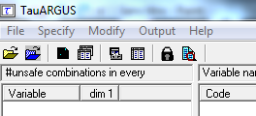
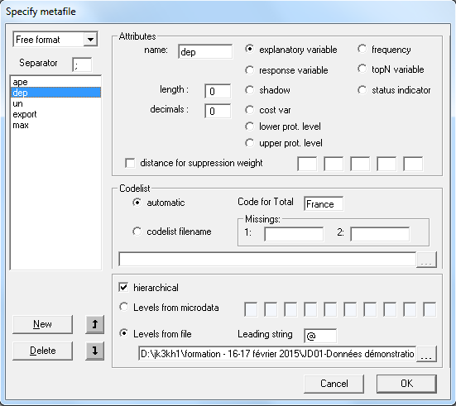
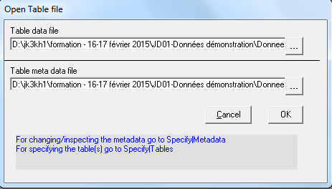
Tabulated data - metadata
Characteristics relating to the boxes of the table and no longer to individuals, in particular:
- the response variable
- the ventilation variables
- the value of the first contributor (top N variable) for dominance
- the frequency of the box (frequency)
Notes:
2 manières d’obtenir le secret primaire : avec TopN et freq (ce qu’on fait
Ou avec status indic et eventuellement lower/upper prot lvl

Slide 35
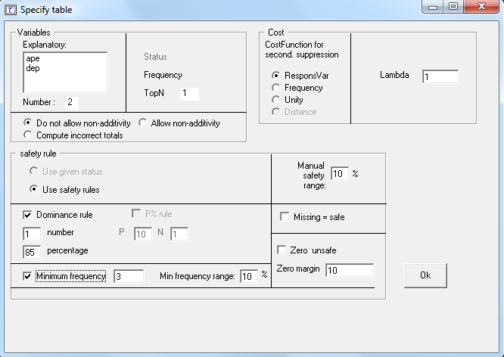
Tabulated data - table specification
1 - Variables selected for the table
2 - Cost management for secondary secrecy
3 - Rules of primary secrecy

Slide 36
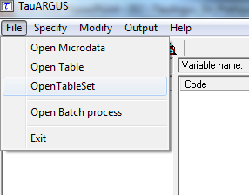
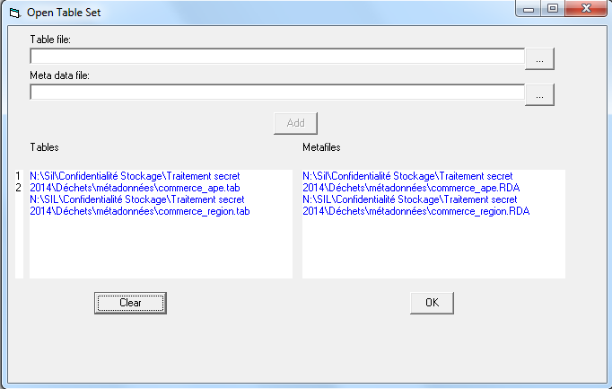
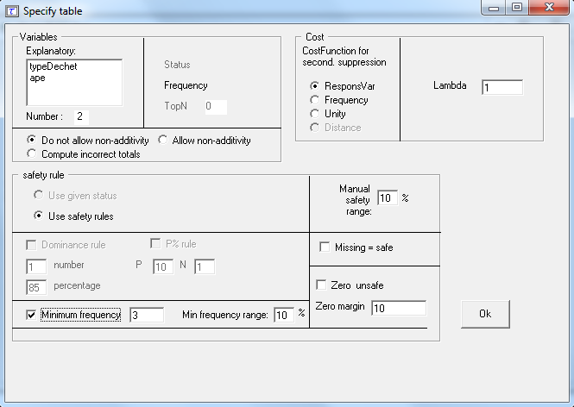
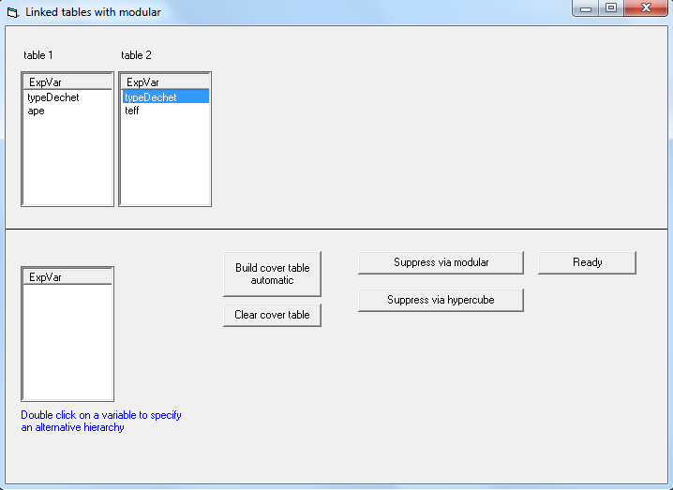
Tabulated data - linked tables
1 - Each tabulated data file and its metadata file are opened, which must be prepared beforehand.
2 - For each table, the rules of primary secrecy are specified.
3 - Finally, you can access the management window of linked tables via the menu.

Slide 37


Confidentiality Management in Aggregate Data Tables
Thanks for your attention ☺
Insee
18 bd Adolphe-Pinard
75675 Paris Cedex 14
www.insee.fr
Informations statistiques :
www.insee.fr / Contacter l’Insee
09 72 72 4000
(coût d’un appel local)
du lundi au vendredi de 9h00 à 17h00

